Slide 1

University Of Dar Es Salaam
COLLEGE OF INFORMATION AND COMMUNICATION TECHNOLOGY (CoICT)
CS 151: COMPUTER ARCHITECTURE AND ORGANIZATION

Slide 2
GROUP MEMBERS
S/N | NAME | REGISTRATION NO | PROGRAMME
1 | MTANZI AMAN KABELEGE | 2023-04-03615 | BSc. CEIT
2 | JOHN WILBALD MARANDU | 2023-04-06579 | BSc. CEIT
3 | ISAKA GEOFREY MTWEVE | 2023-04-09085 | BSc. CEIT
4 | HENDRICK HIPOLITY MARTIN | 2023-04-06639 | BSc. CEIT
5 | VAINA EZEKIEL MOSHI | 2023-04-08513 | BSc. CEIT
Group Members
01

Slide 3
CONTENTS
This presentation covers the following contents:
Bus Arbitration.
Bus Timing Types.
I/O Modules
I/O Address Decoding
Programmed and Interrupt-driven I/O
Direct Memory Access
Magnetic disks
Contents
02

Slide 4
BUS ARBITRATION
Definitions:
A bus is a communication system that transfers data between components of a computer, or between computers.There are three types of buses, data buses, control and Address busses.
In a computer, components communication via buses with the CPU, when multiple devices tries to access the bus simultaneously this action may lead to coflicts. This bring the concept of BUS ARBITRATION
Bus Arbitration means is the process of resolving conflicts that arise when multiple devices attempt to access the bus at the same time.
It the process by which the current bus master accesses and then leaves the control of the bus and passes it to another bus requesting processor unit. The controller that has access to a bus at an instance is known as a Bus master.
Bus Arbitration procedure is implemented to coordinate the activities of all devices requesting memory transfers. The selection of the bus master must consider the needs of various devices by establishing a priority system for gaining access to the bus.
Bus Arbitration
03

Slide 5
BUS ARBITRATION cont….
Approaches followed in Bus Arbitration:
Centralized arbitration - A single device known as bus controller is responsible for managing access to the bus.
Distributive bus arbitration - In which every device takes part in choosing the new bus master.
Methods of Centralized BUS arbitration:
Daisy Chaining method:
It is a simple and cheaper method where all the bus masters use the same line for making bus requests. The bus grant signal serially propagates through each master until it encounters the first one that is requesting access to the bus. This master blocks the propagation of the bus grant signal; therefore, any other requesting module will not receive the grant signal and hence cannot access the bus.
It is simple and scalability and the user may add more devices anywhere along the chain up to certain maximum level. Disadvantage of this is that propagation delays rises in this method and if one device fails the whole system will stop working
Bus Arbitration
04

Slide 6
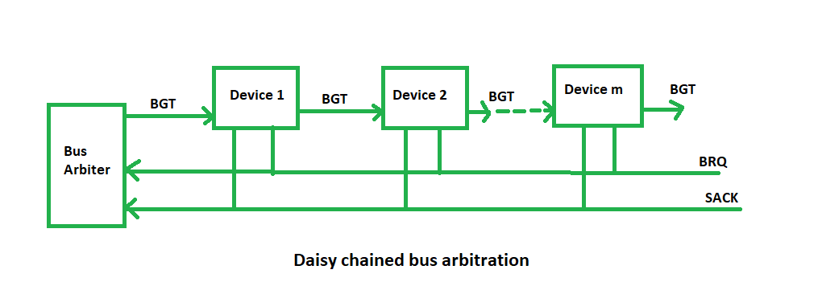
BUS ARBITRATION cont….
Figure 1: Daisy chained bus arbitration
BGT- bus grant signal BQR-bus common request line
SACK-signal acknowledgement (active when the bus is idle)
Bus Arbitration
05

Slide 7
BUS ARBITRATION cont….
Polling or Rotating Priority method:
In this, the controller is used to generate the address for the master (unique priority), the number of address lines required depends on the number of masters connected in the system.
The controller generates a sequence of master addresses. When the requesting master recognizes its address, it activates the busy line and begins to use the bus. Requesting master recognizes its address, it activates the busy line and begins to use the bus.
This method does not favor any device.
Bus Arbitration
06

Slide 8
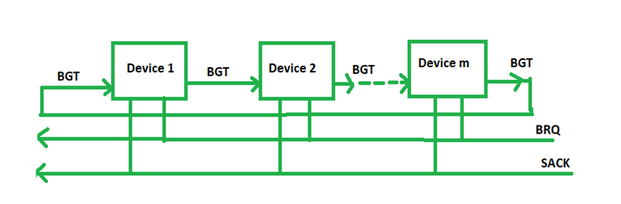
BUS ARBITRATION cont….
Figure 2: Rotating priority bus arbitration
Bus Arbitration
07

Slide 9
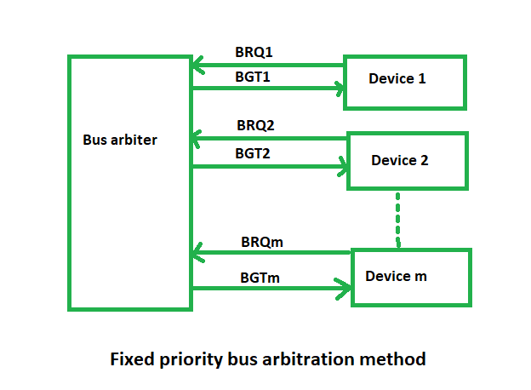
BUS ARBITRATION cont….
Fixed priority or Independent Request method:
In this, each master has a separate pair of bus request and bus grant lines and each pair has a priority assigned to it. The built-in priority decoder within the controller selects the highest priority request and asserts the corresponding bus grant signal.
Figure 3: Fixed priority bus arbitration method.
Bus Arbitration
08

Slide 10
BUS TIMING TYPES
Definition:
Bus timing: Timing refers to the mechanism where communication over a bus is coordinated. It is the process of ensuring that data transfers and requests happen properly and in time. This is done by using a clock signal to synchronize the components of the system.
Bus Timing Types:
Synchronous Bus Timing:
Synchronous bus timing uses a global clock signal to synchronize all communication events between components. Synchronous timing is controlled by a clock thus events are determined by clock signals.
A control bus in a synchronous system includes a clock line that sends periodic signals of alternating 1s and 0s. Devices use this signal to synchronize operations, with events like data transfer or control commands triggered at the rising edge of each clock pulse. Operations are timed to fit within clock cycles for coordination.
Bus Timing Types
09

Slide 11
BUS TIMING TYPES cont…
Advantages of Synchronous Data Timing.
Simplifies the design as all components operate in lockstep with the clock. Since all operations are clock-driven, timing is uniform, which simplifies the design.
Supports high-speed data transfers due to predictable timing. A single clock cycle can complete many operations, especially in fast systems like modern CPUs.
Disadvantages of Synchronous Bus Timing
Requires all components to operate at the same speed as the bus clock, which can limit flexibility.
May lead to inefficiency when slower devices are connected to a fast bus.
Applications of Synchronous Bus Timing.
Synchronous bus is frequently used in modern CPUs and memory subsystems, where speed is critical and predictable timing enhances performance
Bus Timing Types
10

Slide 12
BUS TIMING TYPES cont…
Asynchronous Bus Timing:
In asynchronous bus timing, the occurrence of one event on a bus follows and depends on the occurrence of a previous event. Data transfer is controlled by a "handshaking" exchange between devices.
The device initiating communication (the master) signals its readiness to send or receive data, and the addressed device (the slave) responds when it is ready to proceed.
This method allows devices of varying speeds to communicate effectively, but it can result in slower overall performance compared to synchronous buses.
The master device (initiator of communication) signals its readiness to send or receive data using control signals. The slave device (responding component) signals back when it is ready, completing the handshake
Bus Timing Types
11

Slide 13
BUS TIMING TYPES cont…
Advantages of Asynchronous Bus Timing.
Allows devices with different speeds to communicate, increasing flexibility.
Efficient for systems where component speeds vary significantly.
Disadvantages of Asynchronous Bus Timing.
The main disadvantage of asynchronous bus timing is that, it is slower than synchronous buses because the handshake process introduces additional latency.
Application of Asynchronous Bus Timing.
Asynchronous buses are common in systems with peripherals or where compatibility across diverse components is essential since this involves devices with different speed.
Example; A computer connected to a printer, the computer (master) sends a request to the printer. The printer (slave) acknowledges when it is ready to receive data (completing handshaking). The data is sent, and the printer signals when the transfer is complete.
Bus Timing Types
12

Slide 14
I/O MODULE
Definition:
An I/O module: I/O module serves as a connection point between a computer system and an external device, such as a printer, webcam, or scanner.
This module allows the computer to interact effectively with various peripheral devices, enabling it to perform its intended function of communicating with the external devices effectively.
For example, USB controller, Serial and parallel ports, Network interface card (NIC).
FUNCTIONS OF I/O MODULE
Processor communication: This involves a number of tasks, primarily the transference of data between the processor and an I/O module, accepting and decoding commands sent by the processor, reporting of current status, and an ability for the I/O module to recognize its own unique address.
Device communication: It needs to be able to perform standard device communications, such as reporting of status.
I/O Module
13

Slide 15
I/O MODULE cont…
FUNCTIONS OF I/O MODULE cont….
Control and timing: An I/O module need to be capable of managing data flow between a computer’s internal resources and any connected external devices.
Data buffering: A crucial function that manages the speed discrepancy that exists between the speed of transfer of data between the processor and memory and peripheral devices.
Error detection: Detecting errors, whether mechanical (such as a printer experiencing a paper jam) or data based, and reporting them to the processor is another vital function of an I/O module.
I/O Module
14

Slide 16
I/O ADDRESS DECODING
Definition:
I/O address decoding: This is the process of mapping specific memory addresses or I/O address space to I/O devices or peripherals (like keyboards, printers, or disk drives) so that the CPU can communicate with them.
I/O address space is an address space dedicated to accessing peripheral devices. Hence, its typically mapped to a specific range of addresses which CPU uses to read from or write to I/O devices.
Each I/O device is assigned a unique address or range of addresses. The key purpose of address decoding is to ensure that when the CPU issues a command to certain I/O address, only the appropriate peripheral device will respond to that command in order to avoid unintended behavior like conflicts in the system.
I/O Address Decoding
15

Slide 17
I/O ADDRESS DECODING cont…
Mechanism:
The CPU generates an I/O address for target device and passes it through address bus which transmits the address to the address decoder.
Now, the address decoder examines address sent by CPU and decides which peripheral device the address corresponds to such that if CPU issues an address within range assigned to device 1, the decoder will activate device 1’s chip select signal.
Then, CPU performs read or write operation to the selected device. If the operation is read, CPU reads data from I/O devices memory meaning device places data onto bus and CPU reads it or else if it writes, then CPU sends data to the I/O device memory where CPU places data onto bus and device stores it in its memory.
After the operation, signals are deserted and device is deselected.
I/O Address Decoding
16

Slide 18
I/O ADDRESS DECODING cont…
Main types of I/O address decoding:
1. Full Address Decoding
This method uses all address lines to decode the address, ensuring that each device or memory location is uniquely identified.
Advantages: No overlap between addresses, which means fewer errors and conflicts. Also offers precise and reliable selection of devices.
Disadvantages: Requires more hardware, such as decoders or logic gates. Also Can be more expensive and complex to implement.
2. Partial Address Decoding.
This method uses only a subset of address lines for decoding, where multiple devices respond to the same address range.
Advantages: Simpler and cheaper to implement because it uses fewer address lines.
Disadvantages: Potential for address overlap, leading to errors. And Less precise compared to full address decoding.
I/O Address Decoding
17

Slide 19
I/O ADDRESS DECODING cont…
WHY IS ADDRESS DECODING IMPORTANT?
Prevents conflicts; it ensures each device has unique address.
Enables correct data transfer; the device activated will receive the required data.
Optimizes performance; it reduces need for complex bus arbitration.
Scalability; it ensures CPU can handle new devices without major changes to the overall architecture.
Simplifies system design; by clearly defining device address and supporting modularity.
Optimizes resource management; ensuring efficient use of available address space.
I/O Address Decoding
18

Slide 20
PROGRAMMED AND INTERRUPT-DRIVEN I/O
Definition:
Input/output (I/O) operations are fundamental to computer systems. They allow the system to interact with external devices such as keyboards, mice, printers, and other peripherals. Operations between CPU and I/O devices can be processed by several modes in computer system. There are two main ways used in I/O operations and they include Programmed I/O and Interrupt-driven (interrupt-initiated) I/O.
Programmed I/O: This is a simple method of performing I/O operations. In programmed I/O, the processor directly communicates with the I/O device to transfer data.
This mode involves the following steps:
The processor sends a request to the I/O device to transfer data.
The I/O device responds to the request by sending or receiving data.
The processor waits for the I/O operation to complete before moving on to the next instruction.
Programmed And Interrupt-driven I/O
19

Slide 21
PROGRAMMED AND INTERRUPT-DRIVEN I/O cont…
Programmed I/O is a synchronous operation, which means that the processor waits for the I/O device to respond before it can execute the next instruction. This method is suitable for simple I/O operations that involve small amounts of data.
Advantages of Programmed I/O
Provides simple and easy interfaces to programs.
Direct access to interact with the CPU without involving any peripheral devices in the process.
Disadvantages of Programmed I/O
Synchronization is not efficient in terms of the CPU time as it will need to loop waiting for the device to be ready.
The CPU is idle and cannot handle any other task at the time it waits for the I/O device to complete processing.
Programmed And Interrupt-driven I/O
20

Slide 22
PROGRAMMED AND INTERRUPT-DRIVEN I/O cont…
Interrupt-driven I/O: An interrupt-driven I/O is a mode of data transfer in which an I/O device informs the CPU that it is ready for communication and requests the attention of the CPU.
This mode involves the following:
The I/O device sends an interrupt signal to the processor when it is ready to send or receive data.
The processor then suspends its current task and services the interrupt request.
Once the interrupt request is serviced, the processor resumes its previous task.
Interrupt-driven I/O is an asynchronous operation, which means that the processor does not have to wait for the I/O device to respond. This method is suitable for complex I/O operations that involve large amounts of data.
Programmed And Interrupt-driven I/O
21

Slide 23
PROGRAMMED AND INTERRUPT-DRIVEN I/O cont…
Advantages of Interrupt-Initiated I/O
Reduced overhead on the CPU as the same CPU waits for an interrupt while doing other tasks at the same instance.
There is also no need for monitoring the status of a specific device.
Reduces CPU time wastage, hence enhancing the performance of the system.
Disadvantages of Interrupt-Initiated I/O
Difficult to implement and program in contrast to sequential file processing or compared to it when it is implemented in low-level languages.
Needs interrupt handling routines, which can be time-consuming.
Programmed And Interrupt-driven I/O
22

Slide 24
PROGRAMMED AND INTERRUPT-DRIVEN I/O cont…
DIFFERENCES BETWEEN PROGRAMMED I/O AND INTERRUPT-DRIVEN I/O
S/N | PROGRAMMED I/O | INTERRUPT-DRIVEN I/O
1 | Data transfer is initiated by the means of instructions stored in the computer program. Whenever there is a request for I/O transfer the instructions are executed from the program. | The I/O transfer is initiated by the interrupt command issued to the CPU.
2 | The CPU stays in the loop to know if the device is ready for transfer and has to continuously monitor the peripheral device. | There is no need for the CPU to stay in the loop as the interrupt command interrupts the CPU when the device is ready for data transfer.
3 | This leads to the wastage of CPU cycles as CPU remains busy needlessly and thus the efficiency of system gets reduced. | The CPU cycles are not wasted as CPU continues with other work during this time and hence this method is more efficient.
4 | CPU cannot do any work until the transfer is complete as it has to stay in the loop to continuously monitor the peripheral device. | CPU can do any other work until it is interrupted by the command indicating the readiness of device for data transfer
5 | Its module is treated as a slow module. | Its module is faster than programmed I/O module.
6 | It is quite easy to program and understand. | It can be tricky and complicated to understand if one uses low level language.
Programmed And Interrupt-driven I/O
23

Slide 25
DIRECT MEMORY ACCESS (DMA)
Definition:
Direct memory access (DMA): This is a computer feature that allows hardware subsystems to access the main memory of a system without the central processing unit (CPU).
DMA uses a DMA controller to transfer data between the device and the memory. This method is faster than other methods for transferring large amounts of data.
DMA is used by devices such as: Disk drives, External memory, Graphics cards, Network cards, and Sound cards.
In modern computer systems, transferring data between input/output devices and memory can be a slow process if the CPU is required to manage every step.
By solving this DMA controller is used. DMA increases system efficiency and speeds up data transfers, freeing the CPU to focus on other tasks.
Direct Memory Access (DMA)
24

Slide 26
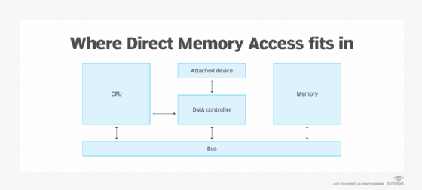
DIRECT MEMORY ACCESS (DMA) cont…
In understanding this we need to know what is DMA controller?
DMA controller is the hardware that has the work of transferring the data between input output devices and the main memory with very less interaction with the processor.
The DMA controller is a control unit, which has the work of transferring data hence acting as the interface for the data bus and the I/O devices.
Direct Memory Access (DMA)
25

Slide 27
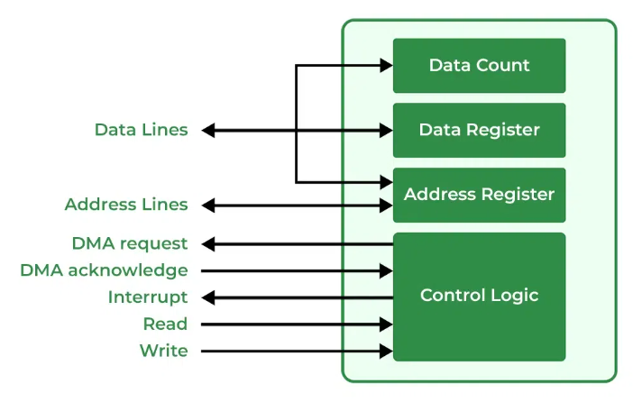
DIRECT MEMORY ACCESS (DMA) cont…
DMA controller also has the address unit which generates the address and selects an I/O device for the transfer of data.
The block diagram of DMA controller
Direct Memory Access (DMA)
26

Slide 28
DIRECT MEMORY ACCESS (DMA) cont…
Types of Direct Memory Access (DMA)
Single-Ended DMA: Single-Ended DMA Controllers operate by reading and writing from a single memory address. They are the simplest DMA.
Dual-Ended DMA: Dual-Ended DMA controllers can read and write from two memory addresses. Dual-ended DMA is more advanced than single-ended DMA.
Arbitrated-Ended DMA: Arbitrated-Ended DMA works by reading and writing to several memory addresses. It is more advanced than Dual-Ended DMA.
Interleaved DMA: Interleaved DMA are those DMA that read from one memory address and write from another memory address.
Direct Memory Access (DMA)
27

Slide 29
DIRECT MEMORY ACCESS (DMA) cont…
Working of DMA Controller
The DMA controller registers have three registers as follows: Address register – It contains the address to specify the desired location in memory, Word count register – It contains the number of words to be transferred, and Control register – It specifies the transfer mode.
A DMA controller regulates the data flow between memory and an auxiliary device. The controller is plugged into the computer system’s motherboard and connected to the devices that need data transfer via connectors. Once the data flow is established, the computer system temporarily suspends its operation, and the DMA controller takes over.
The controller temporarily takes control of the system bus and sends the data directly to the device without any assistance from the CPU. When we complete the transfer operation, the DMA controller relinquishes control to the CPU. Therefore, the system resumes its normal operations.
Direct Memory Access (DMA)
28

Slide 30
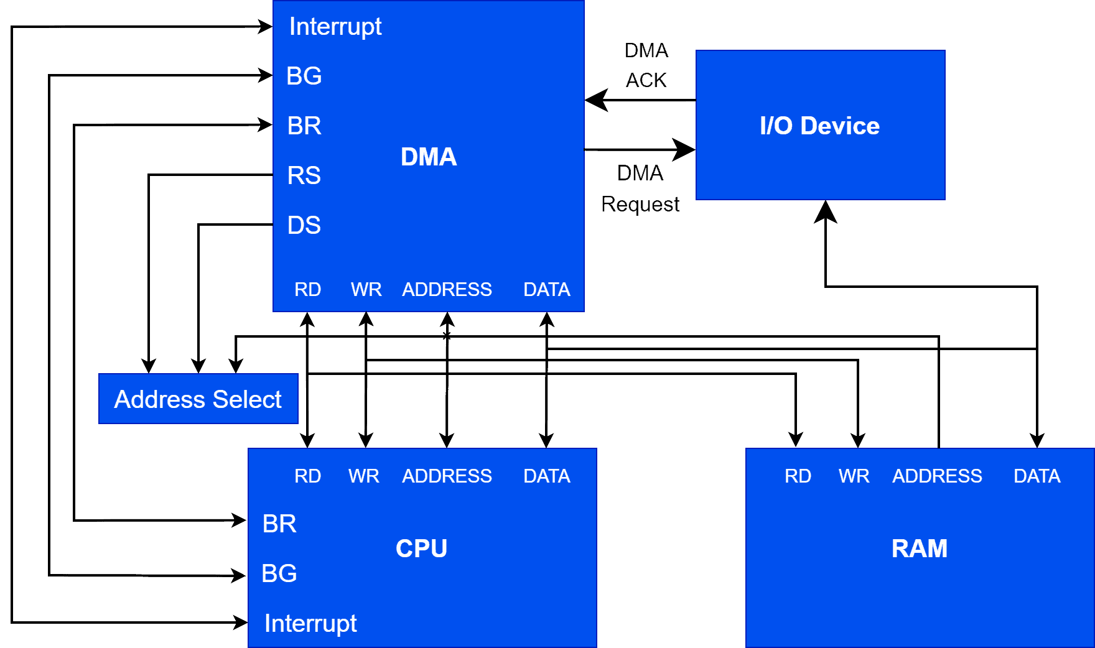
DIRECT MEMORY ACCESS (DMA) cont…
Block Diagram of DMA
Direct Memory Access (DMA)
29

Slide 31
DIRECT MEMORY ACCESS (DMA) cont…
The DMA controller moves data to and from memory using one of the following method:
Burst mode: When the CPU gives the DMA controller access to the system bus, the DMA controller transfers the whole data block in one contiguous sequence. Once completed, control of the bus reverts back to the CPU. This method causes the CPU to be inactive while transferring data.
Cycle-stealing mode: The DMA controller accesses the system bus in the same way as burst mode, but control of the system bus reverts to the CPU using a Bus Grant after one byte is transferred. Another Bus Request is initiated, and the process is repeated until the whole data block is transferred.
Transparent mode: The DMA controller transfers data only when the CPU is executing operations that don't use system buses. With this DMA transfer method, the CPU doesn't have to stop performing its operations. Transparent mode DMA operations takes the longest to transfer data blocks, but it's the most efficient mode in terms of system performance.
Direct Memory Access (DMA)
30

Slide 32
DIRECT MEMORY ACCESS (DMA) cont…
Advantages of DMA Controller
Data Memory Access speeds up memory operations and data transfer.
CPU is not involved while transferring data.
DMA requires very few clock cycles while transferring data.
DMA distributes workload very appropriately.
DMA helps the CPU in decreasing its load.
Disadvantages of DMA Controller
Direct Memory Access is a costly operation because of additional operations.
DMA suffers from Cache-coherent-problems.
DMA Controller increases the overall cost of the system.
DMA Controller increases the complexity of the software.
Direct Memory Access (DMA)
31

Slide 33
MAGNETIC DISKS
Definition:
A magnetic Disk: This is a type of secondary memory that is a flat disc covered with a magnetic coating to hold information.
It is a storage device that uses a magnetization process to write, rewrite and access data.
It is used to store various programs and files.
Examples of magnetic disks: Hard disks, zip disks and floppy disks are common examples of magnetic disks.
Magnetic Disks
32

Slide 34
MAGNETIC DISKS cont…
STRUCTURE OF MAGNETIC DISK
Magnetic disk contains the following explained main parts:
Platters: Circular disks made of aluminum, glass, or ceramic, coated with a thin layer of ferromagnetic material (e.g., cobalt alloys) to store magnetic information.
Read/Write Heads: Tiny electromagnetic devices positioned above each platter surface. Operates without touching the platter, hovering at a microscopic distance (a few nanometers) to avoid wear.
Spindle Motor: Rotates the platters at high speeds (e.g., 5400 RPM to 15,000 RPM in modern drives). Ensures constant rotation for read/write operations.
Actuator Arm: Mechanically moves the read/write heads across the platter surface. Controlled by a voice coil motor (VCM), which uses electromagnetic force for precise positioning.
Disk Controller: An embedded processor that manages read/write operations, error correction, and data transfer between the disk and the computer.
Magnetic Disks
33

Slide 35
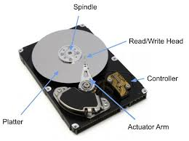
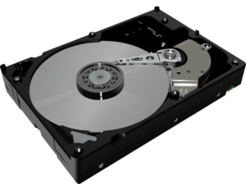
MAGNETIC DISKS cont…
Typical Magnetic Disk Structure
Magnetic Disks
34

Slide 36
MAGNETIC DISKS cont…
MECHANISM OF MAGNETIC DISKS
A magnetic hard disk operates by using magnetic fields to store binary data. The surface of the disk platter is coated with a magnetic material where data is recorded as changes in magnetization direction. The read/write head, a key component, hovers above the platter's surface to access data. During writing, the head magnetizes regions of the disk to represent binary information, while during reading, it detects these magnetic changes and converts them into electrical signals that the computer can interpret.
The disk platters are organized into concentric tracks, further divided into sectors, forming a grid-like structure for efficient data storage and retrieval. When a computer requests data, the actuator arm moves the read/write head to the correct track, and the spinning platter positions the desired sector beneath the head.
The magnetic hard disk’s spindle motor rotates the platters at high speeds, creating an air cushion that keeps the read/write head from contacting the platter surface. This combination of mechanical and electromagnetic systems allows the magnetic disk to achieve reliable, high-capacity data storage with rapid access times.
Magnetic Disks
35

Slide 37
MAGNETIC DISKS cont...
ADVANTAGES OF MAGNETIC DISKS
High Storage Capacity: Magnetic disks, such as hard disk drives (HDDs), offer a large amount of storage space at a relatively low cost compared to other storage technologies
Random Access Capability: Unlike sequential storage devices (e.g., magnetic tapes), magnetic disks provide direct (random) access to data. This allows the system to quickly read or write data from any location on the disk.
Durability and Reusability: Magnetic disks are designed to endure multiple read and write operations without significant degradation, making them reliable for long-term use.
DISADVANTAGES OF MAGNETIC DISKS
Susceptibility to Physical Damage: Magnetic disks contain mechanical components such as spinning platters and read/write heads, making them prone to damage from physical shock
Slower Compared to SSDs: While magnetic disks are faster than tapes, they are significantly slower than solid-state drives (SSDs).
Magnetic Disks
36

Slide 38
THANK YOU FOR YOUR TIME
Appreciations
37

